Slide 1
Josephus problem
Teacher : Sharmila KP
Team : Kumar Aashish Raj
Md. Akhtar Ali
Ayushman Sinha
Shreyanshu Shubham

Slide 2
Acknowledgement
First and foremost, I would like to thank our Teacher Mrs. Sharmila KP who guided us through out this assignment.
She provided us with invaluable advice and helped us a lot.
Her motivation and help contributed tremendously to the successful completion of the assignment.
Besides, we would like to thank our fellow members who helped us by giving us advice and providing the valuable strategy which we needed.
At last but not least, we would like to thank everyone who helped and motivated us to work on this assignment.

Slide 3
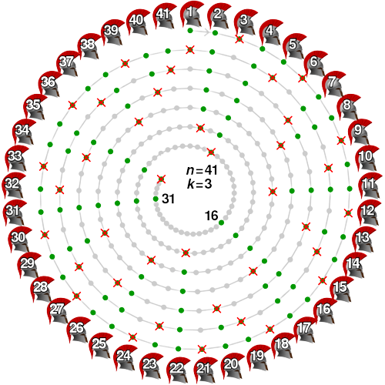
What is Josephus
problem?

Slide 4
Problem statement:
There are n people standing in a circle waiting to be executed. The counting out begins at some point in the circle and proceeds around the circle in a fixed direction. In each step, a certain number of people are skipped and the next person is executed. The elimination proceeds around the circle (which is becoming smaller and smaller as the executed people are removed), until only the last person remains, who is given freedom. Given the total number of persons n and a number k which indicates that k-1 persons are skipped and kth person is killed in circle. The task is to choose the place in the initial circle so that you are the last one remaining and so survive.

Slide 5
Example:
If we take n=8 and k=3

Slide 6
8
Safe Place
1
7
2
6
3
5
4

Slide 7
Code using
Circular Linked List:

Slide 8
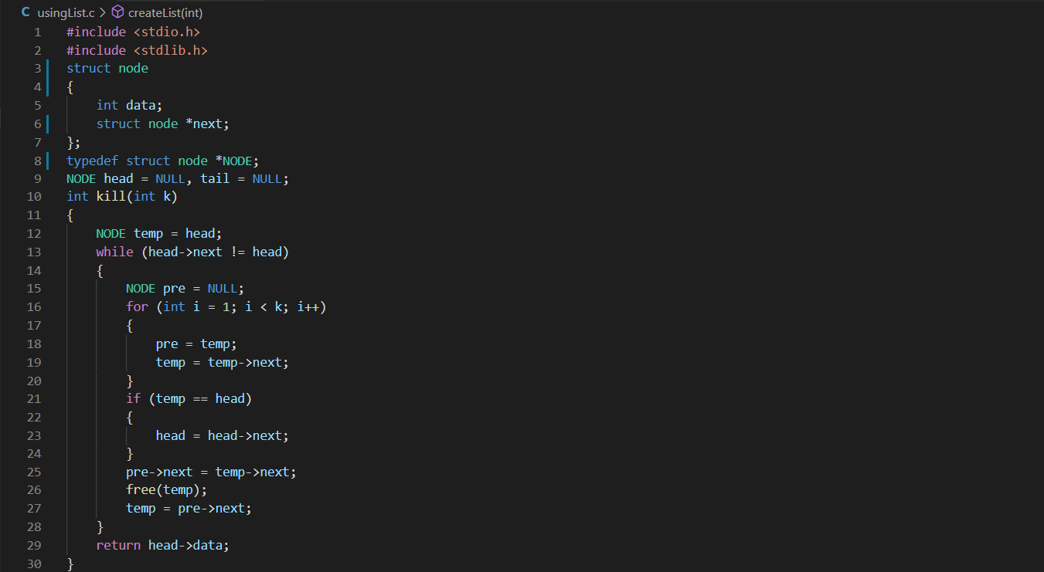

Slide 9
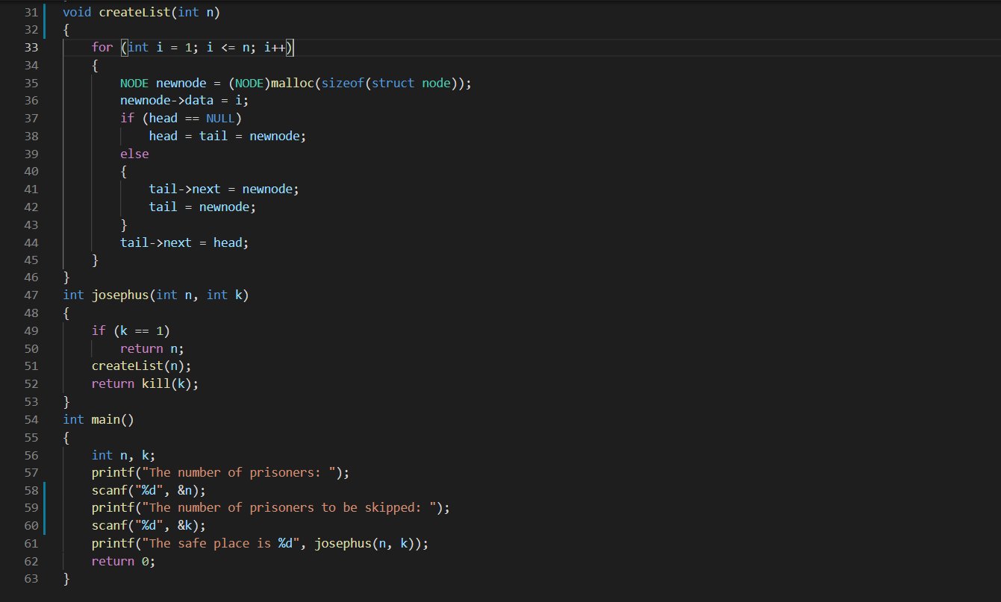

Slide 10
Code Using Recursion:

Slide 11
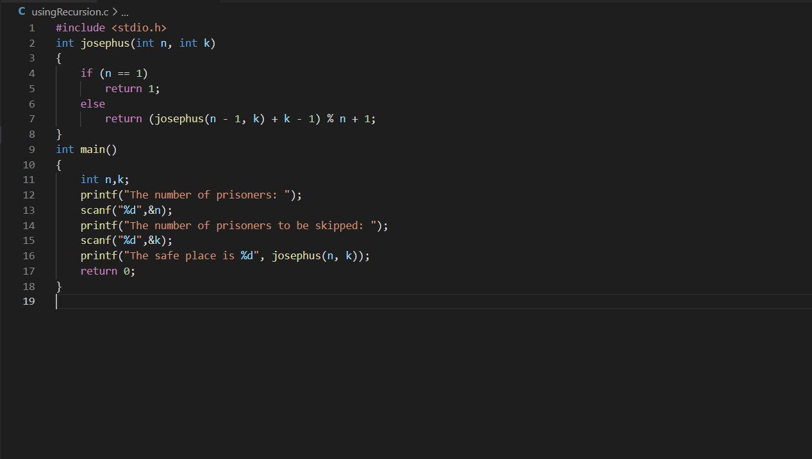

Slide 12
Output:

Slide 13
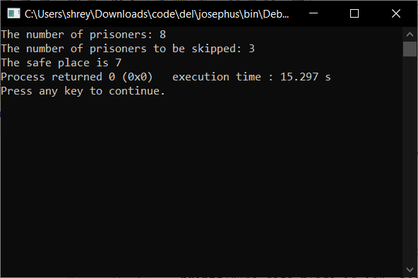
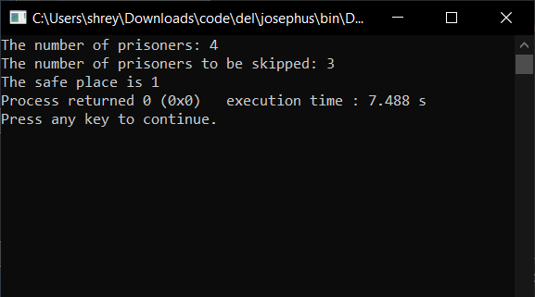
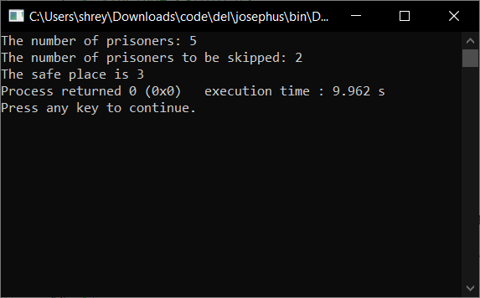
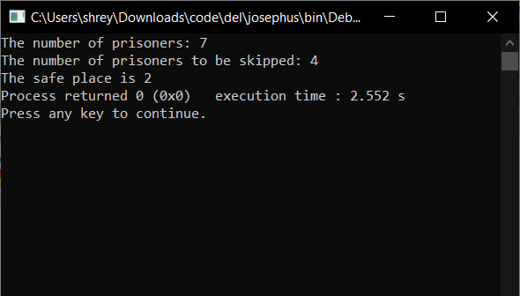

Slide 14
Working of code:

Slide 15
8
1
7
2
6
3
5
4

Slide 16
8
1
7
2
6
3
5
4

Slide 17
8
1
7
2
6
3
5
4

Slide 18
8
1
7
2
6
3
5
4

Slide 19
8
1
7
2
6
3
5
4

Slide 20
8
1
7
2
6
3
5
4

Slide 21
8
1
7
2
6
3
5
4

